Slide 1
Demo of next generation webapp
Terence Law
2022-03-01

Slide 2
Purpose
HKIX NMS project requires a new Admin Portal
To integrate with new Arista infrastructures
Revamp old Admin Portal
Explore modern web services technologies
Suitable for the next 5 to 10 years (Will not be outdated)
Maintainable
Source package dependency control
Easy to inspect and upgrade dependencies
Good performance
Minimal security risk

Slide 3
Requirements
Web interface
HTML5, CSS3, JavaScript
Open standards
Relational database access
MySQL 8
popular, backward compatible
NDB Cluster configuration available
Java based implementation
Application server
Java 11
Java 8 is not recommended for new projects, i.e. will be retired
Java 11 (LTS), Java 17 (LTS) are both in long term support

Slide 4
Java based application server
Jakarta EE 9
All new web services, libraries should support Jakarta EE
Replacing old Java EE
Tomcat 10.0
Stable, secured, good performance
Full support of Jakarta EE
Only Servlet and JSP container
TomEE 9.0
Tomcat 10 + full EJB application server
TomEE Plume

Slide 5
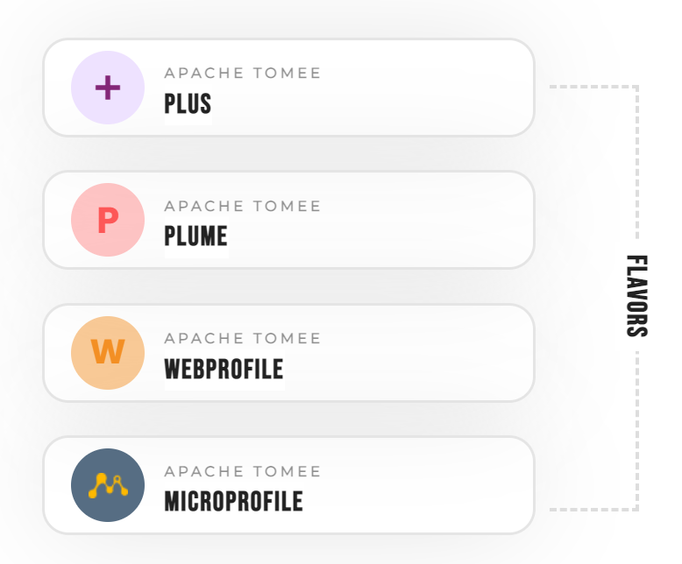
TomEE Plume
Plume
includes all of WebProfile
Context and Dependency Injection (CDI)
Jakarta persistence (JPA)
Enterprise Beans (EJB)
JSON Binding
plus
Jakarta Enterprise Web Services
Jakarta Messaging (JMS)
Jakarta Authentication
Etc.

Slide 6
Web framework – Strut 2
History of security concerns
Extra xml configuration file required
Not standard based
Difficult to modify and upgrade
Not good for new projects

Slide 7
Web framework – Spring 5
Popular web framework for Java
Non standard way to make it work
Need to follow the Spring way
Difficult to do customization
Tie up into Spring, not easy to change
Lots of dependencies
Not easy to control
E.g. simply changing Logger to use seems not obvious to do
Prefer not stuck into Spring

Slide 8
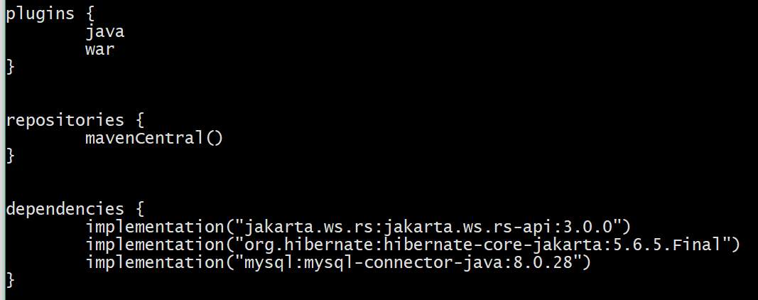
Dependency control
Gradle w/ Kotlin
Simple to use
Edit text file
Build scripts generated
Easy to maintain
No need to edit xml file
No need to copy jar files

Slide 9
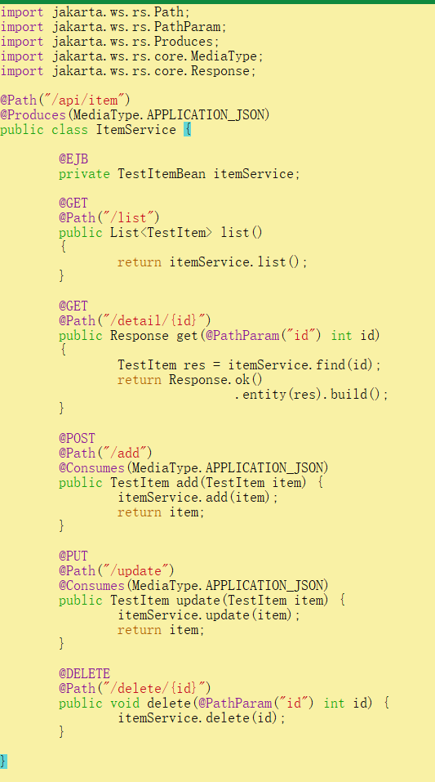
RESTful service
Standard HTTP request/response
JSON content body
GET, POST, PUT, DELETE standard methods
Container managed, dependency injected, EJB (for database access)

Slide 10
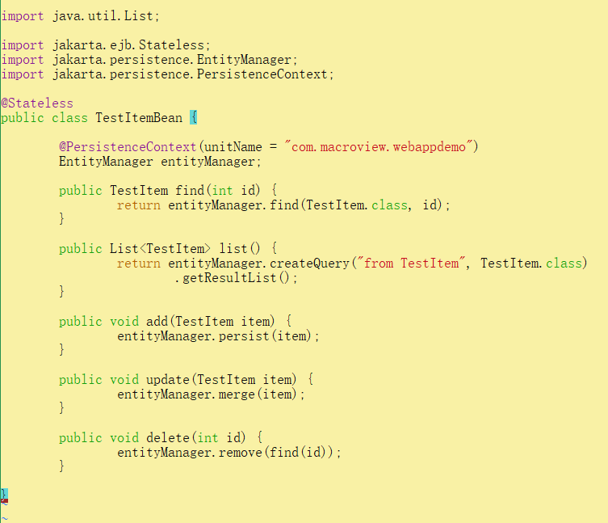
CDI
Context and Dependency Injection
Persistence context of JPA resource
Hibernate is configured as provider of JPA
JPA provider can be changed with minimal source code change

Slide 11
Demo webapp
Working demo webapp in git repository: https://github.com/thwlaw/webappdemo-jakarta-ee.git
Built and deployed as war file

